Slide 1
3GHz FMcw Passive electronic scanning array radar (PESA)
Bolaji Kassim
RF/Microwave Engineer
University at Buffalo
Bachelor of science : electrical engineering 2023

Slide 2
What is the Objective
Goals
To be able to target objects at least 100m away
To be able to discern objects radial velocity
To be able to steer the Radars beam and discriminate multiple objects

Slide 3
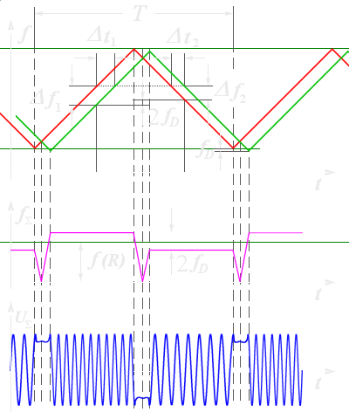

Fundamental math for radar ranging
$$R=c∗\frac{\left|Δt\right|}{2}=\frac{c∗\left|Δf\right|}{2\left(\frac{∂\left(f\right)}{∂\left(t\right)}\right)}$$
R: Range
c: speed of light
|Δt|: Time of signal to target
|Δf|: Down-converted IF Frequency
$\frac{∂\left(f\right)}{∂\left(t\right)}$: modulating (message) signal or m(t)
Radartuturial.eu, Figure 3
https://www.radartutorial.eu/02.basics/Frequency%20Modulated%20Continuous%20Wave%20Radar.en.html

Slide 4


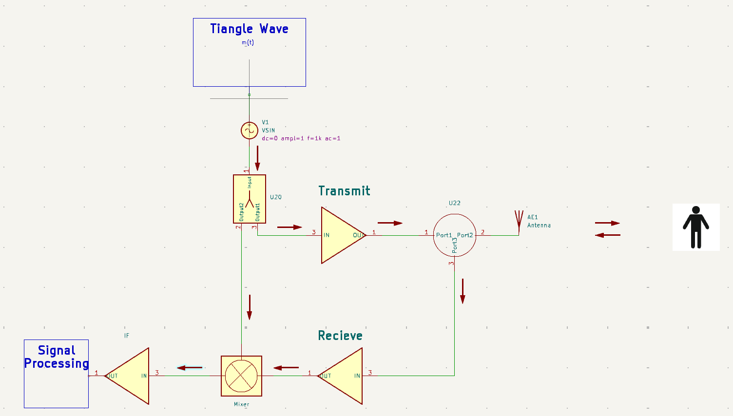
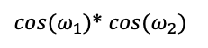
Simplified Block Diagram
Reference Beam
Object Beam
Interference Beam
$\cos{{(ω}_{1})}$* $\cos{{(ω}_{2})}$

Slide 5
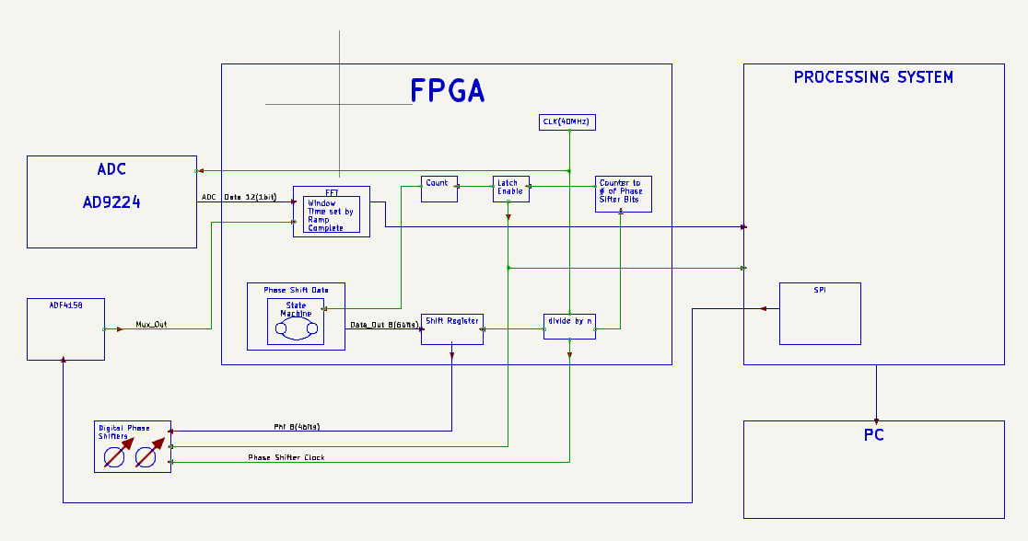
Simplified FPGA Block Diagram (For Signal Processing
Reference Beam
Object Beam
Interference Beam
$\cos{{(ω}_{1})}$* $\cos{{(ω}_{2})}$

Slide 6
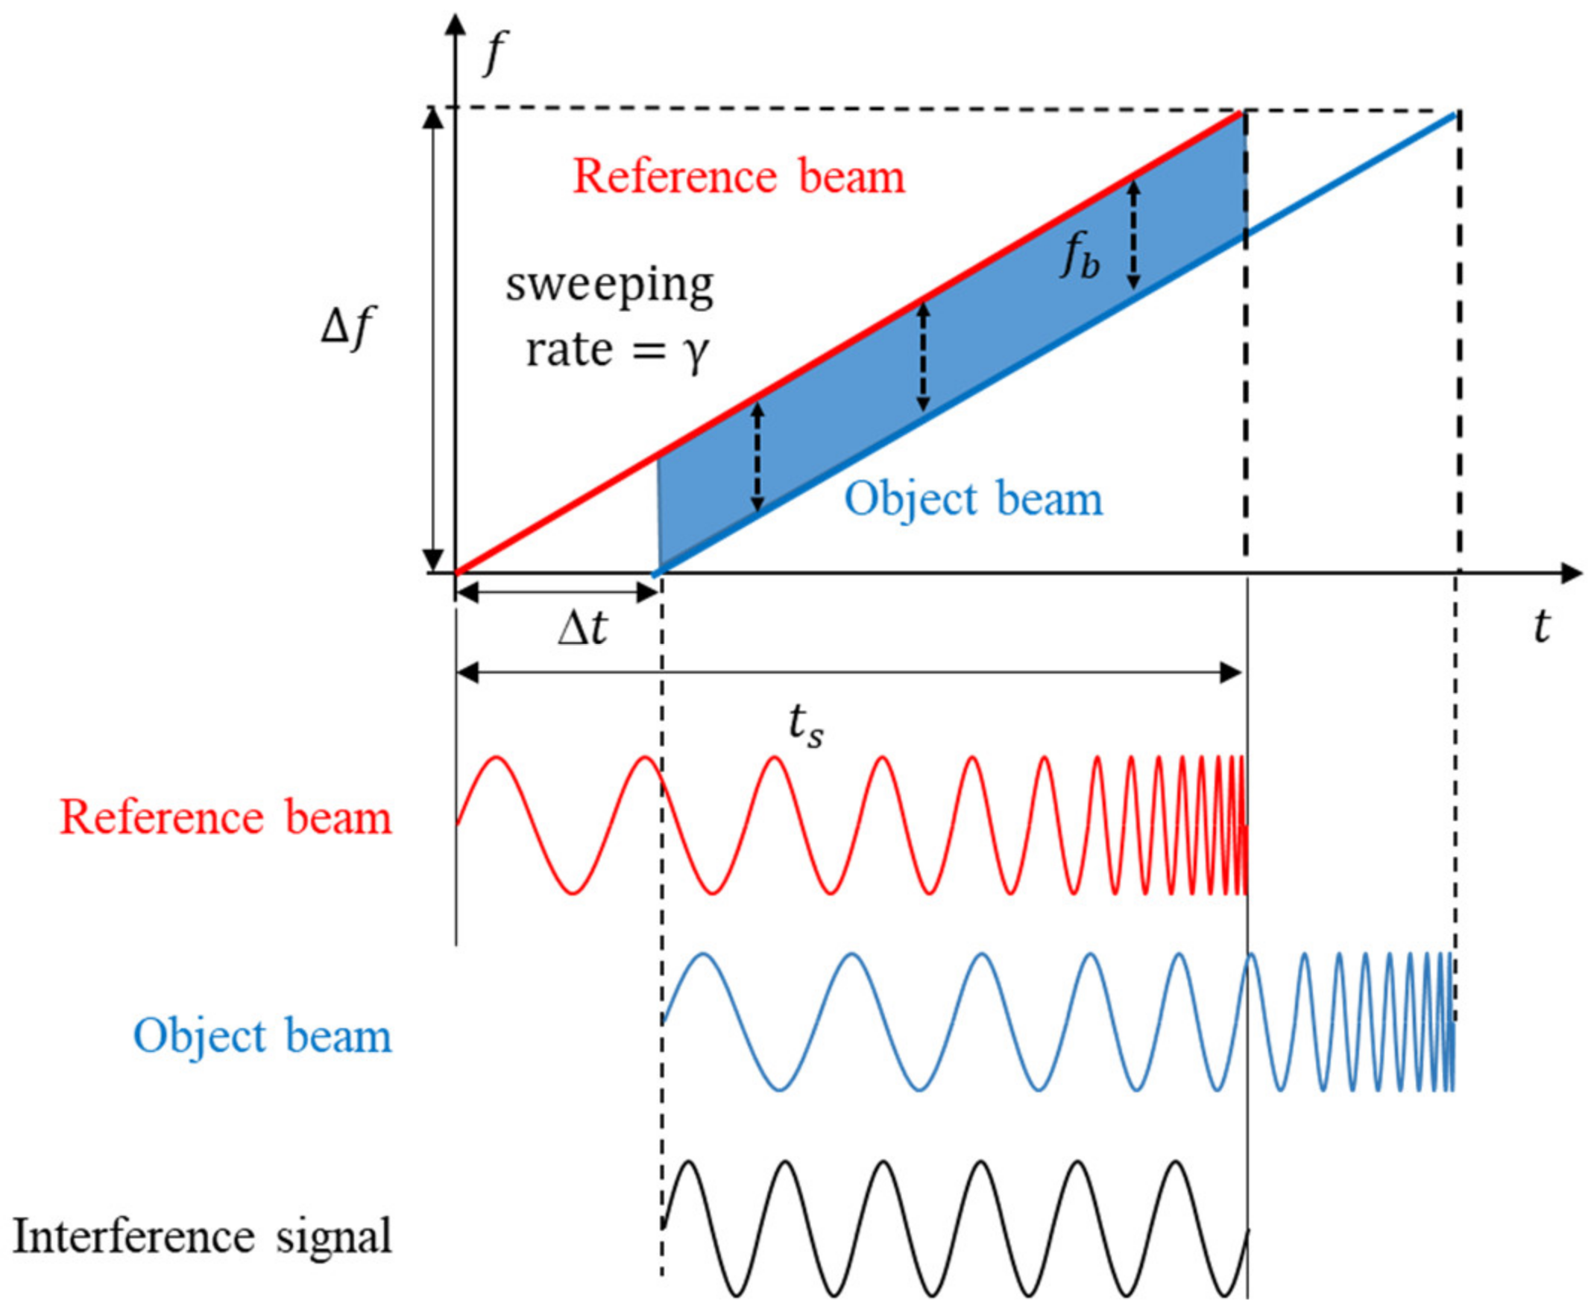
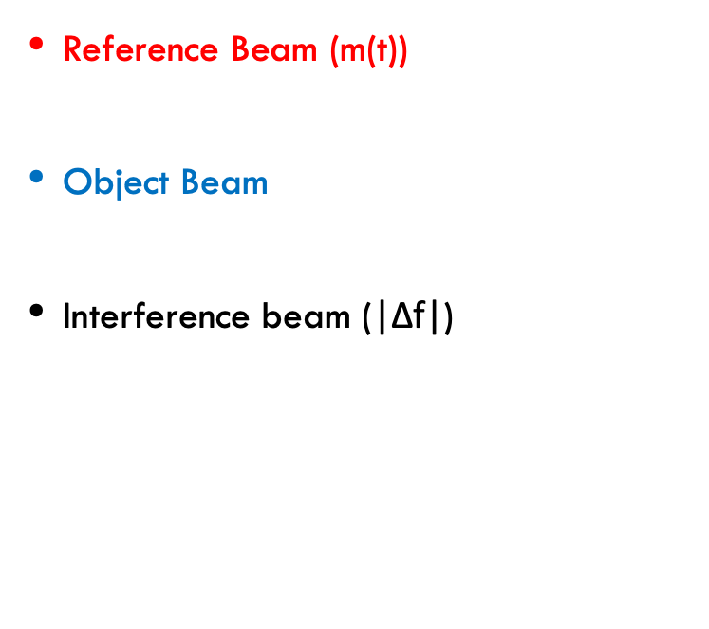
How Objects are detected
Reference Beam (m(t)) is the signal being transmitted to the target
Object Beam is the signal reflected off the object
Interference beam (|Δf|) is the Reference Beam mixed with the Object Beam
$\cos{{(ω}_{1}±ω_{2})}$= $\cos{{(ω}_{1})}$* $\cos{{(ω}_{2})}$
Jubong Lee, Jinseo Hong And Kyihwan Park, “Frequency Modulation Control of an FMCW LiDAR Using a Frequency-to-Voltage Converter,”

Slide 7
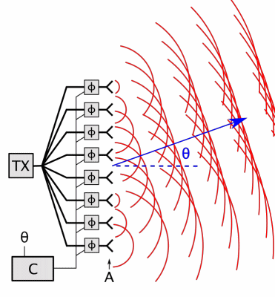
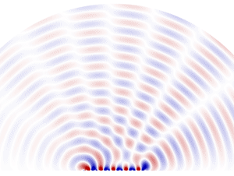
How The Radar can scan field of view
Chetvorno, December 2016
https://commons.wikimedia.org/wiki/File:Phased_array_animation_with_arrow_10frames_371x400px_100ms.gif
The Reference beam is split to several antennas and each antenna has a phase shift relative to each other
Chetvorno, December 2016
https://commons.wikimedia.org/wiki/File:Phased_array_animation_with_arrow_10frames_371x400px_100ms.gif
By changing the relative phase difference between the antennas, you can steer the transmitted Electromagnetic wave
Chetvorno, December 2016
https://commons.wikimedia.org/wiki/File:Phased_array_animation_with_arrow_10frames_371x400px_100ms.gif

Slide 8
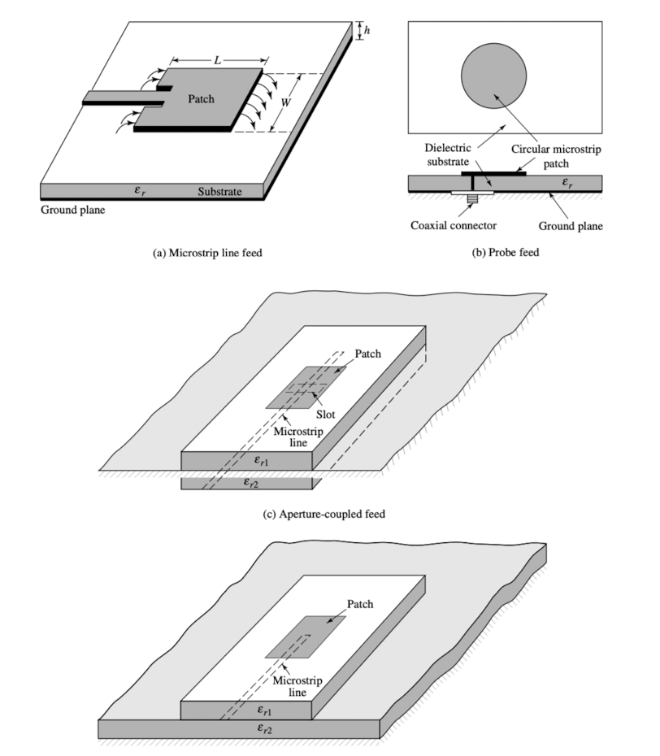
Antenna Structure & Design
There are many different configurations of patch antennas
They vary by shape, size, and feed method
Figures of merit are
Center Frequency (resonant frequency)
Bandwidth
Directivity or gain
C. Balanis, Antenna Theory, Analysis and Design’, pg. 814, 2005.

Slide 9
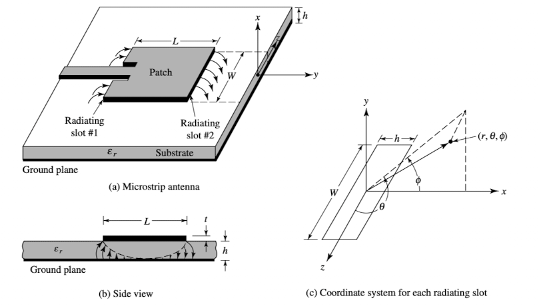
Center Frequency
Mostly effected by length of Patch (L)
Bandwidth
Mostly effected by dielectric constant (𝜀_{r}) & height (h) of dielectric between patch and ground plane
Gain
Mostly effected by size of patch & (array-multiple elements)
C. Balanis, Antenna Theory, Analysis and Design’, pg. 812, 2005.

Slide 10

Design Struggles
Patch Antennas are inherently narrow band structures (Bandwidth <3%)
My design has center frequency of 3GHz and Modulating Bandwidth of 200MHz
$$\frac{3GHz}{200MHz}=6.67\% Bandwidth$$
To solve this problem I used low dielectric & low loss substrate (Rogers RTDurriod 5880) and made it quite thick.
𝜀_{r} = 2.2 (among the lowest available)
h = 300 mils (VERY THICK!, Thicker than your Smartphone.

Slide 11
Thickness was a major challenge
Thickness was a Major Challenge
Harder to feed signal to patch
Impedance of microstrip feedline
Proximity of Coupled feedline
Probe Feed (with slight modification)
Because I wanted the system to exist on one board I used a microstrip feedline with a close ground plane and stacked the dielectric on top of the feedline and used a via (wire) through the dielectric. This allowed me to not have to use a coaxial connector

Slide 12
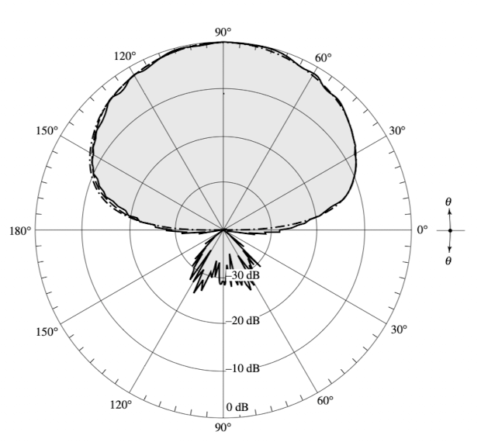
Beam Pattern of Single Patch Element
On the Theta plane
Imagine the beam pattern on the right is a horizontal correctional view of your vision
C. Balanis, Antenna Theory, Analysis and Design’, pg. 814, 2005.

Slide 13
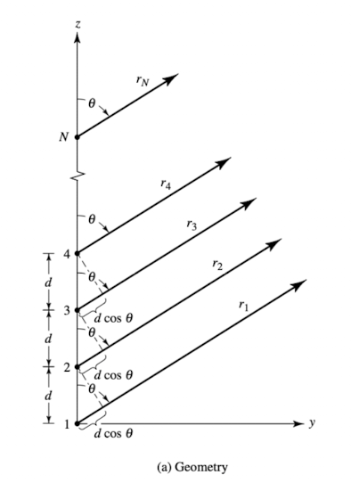

Array factor
Total Electric Field
Electric Field of Single Element* Array Factor
$$AF=\sum_{n=1}^{N}{e^{j(n−1)(k∗d∗\cos{θ+β)}}}$$
N: number of elements
n: individual element index
k: wave number in free space = $\frac{2π}{wavelength}$
d: distance between elements
θ: angle of beam direction
β: Phase difference of Reference Signal between elements
C. Balanis, Antenna Theory, Analysis and Design’, pg. 293, 2005.

Slide 14
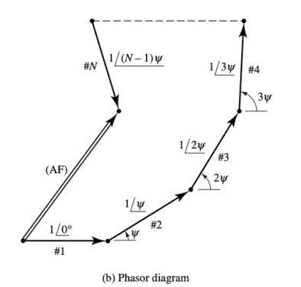
Phasor Diagram of beam direction
As shown in the diagram
The more elements you add, the wider your scanning window
The more elements you add the larger the Magnitude of Array Factor (Stronger/Narrower) Beam
C. Balanis, Antenna Theory, Analysis and Design’, pg. 293, 2005.

Slide 15
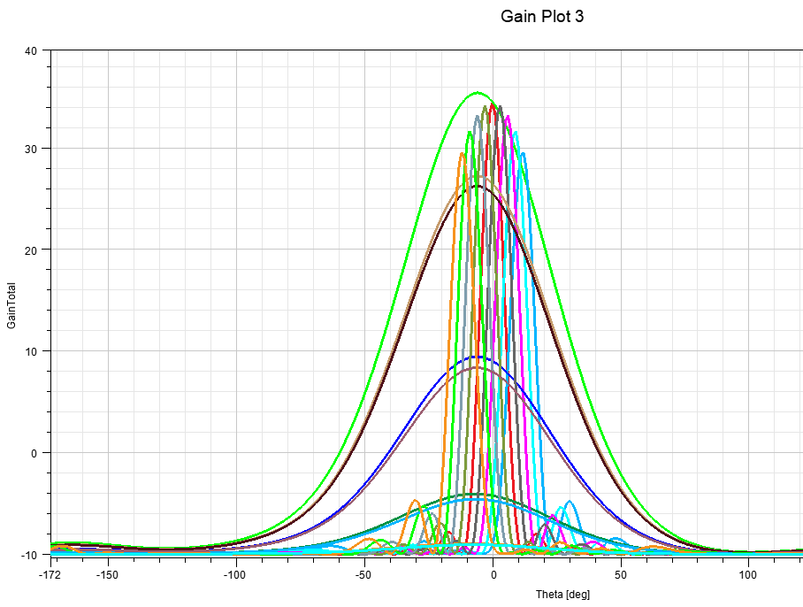

Gain Plot of simulated antenna array
The Traces inside the red box show the gain pattern of the array for each phase delta between elements
G_{n}= Gain of nth element
$λ$ = wavelength
$$AF=\sum_{i=0}^{N}{e^{j(n−1)(k∗d∗\cos{θ+β∗i)}}}$$
$$θ=\left|G_{n}\right|∗\sum_{n=i}^{N}{\cos^{−1}{(\frac{λ β∗i}{2πd})}}$$
$$θ=\left|G_{n}\right|∗\sum_{i=−4}^{4}{\cos^{−1}{(\frac{\text{10}\text{cm}\text{*} 5.25°∗i}{2π60mm})}}$$

Slide 16
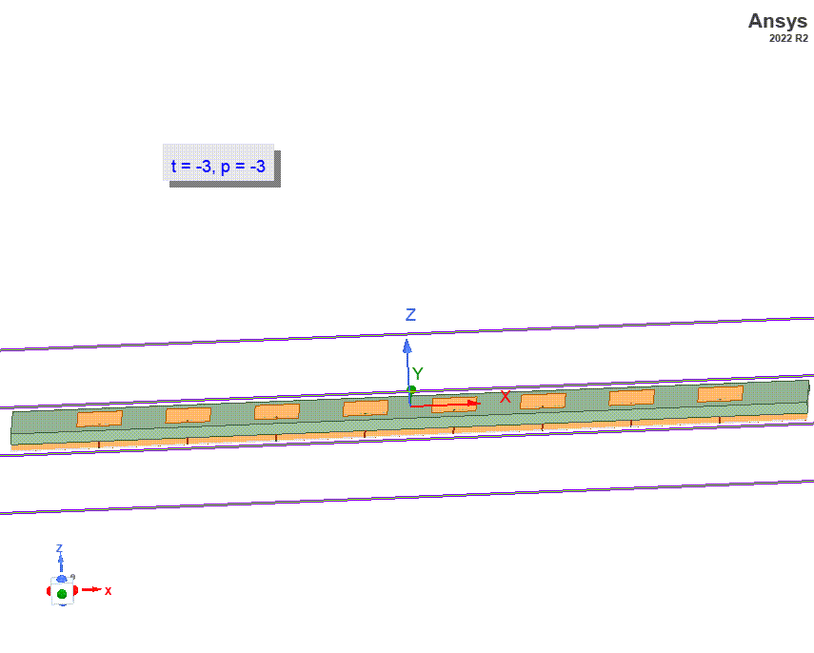
Animation of Finalized Antenna Design

Slide 17
Printed circuit Board Design of the Finished Radar
Dielectric Substrates (𝜀_{r} )
Top Layer – RF Signals/Circuitry
Digital Signals
Layer 2 – Ground
Layer 3 – Power
Layer 4 – Digital Signals
Layer 5 – Ground
Bottom Layer 6 – Antenna Feed

Slide 18
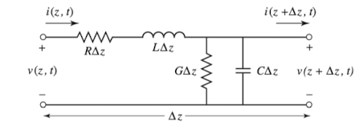
Designing PCB parameters
Characteristic Impedance for Top and Bottom Layer rf traces
50Ω | 0.625mm (width of RF traces)
Transmission Line Model
(RF Traces)
RF Traces
All structures printed on the board follow the transmission line model
series inductance (stores magnetic fields)
causes time delay of current
series resistance (dissipates power through copper trace)
Shunt capacitance (stores electric fields
causes time delay of voltage
Shunt conductance (dissipates power through dielectric)
Ground Plane
D. Pozar, Microwave Engineering, pg. 49, 2011.
Differential Wave Equation
Models the length of trace with respect to ground plane as infinitesimal sections, and relates them to lumped electronic components

Slide 19
Top Layer– RF & Digital Signals

Slide 20

Layer 2 - Ground

Slide 21
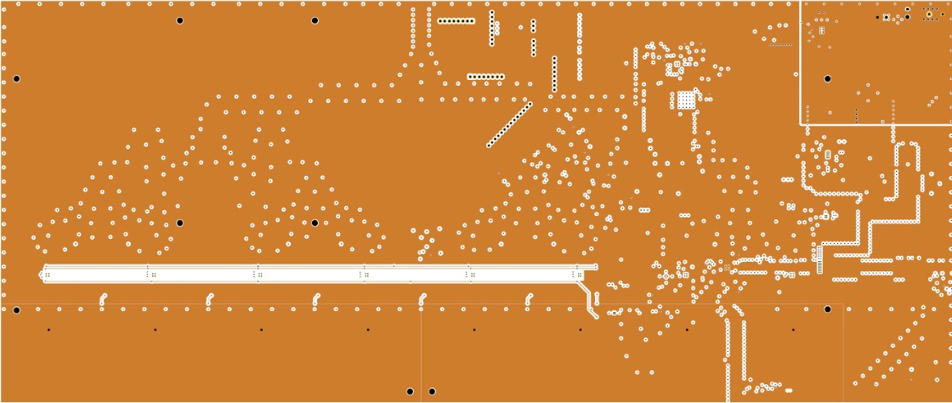
Layer 3 – Power

Slide 22
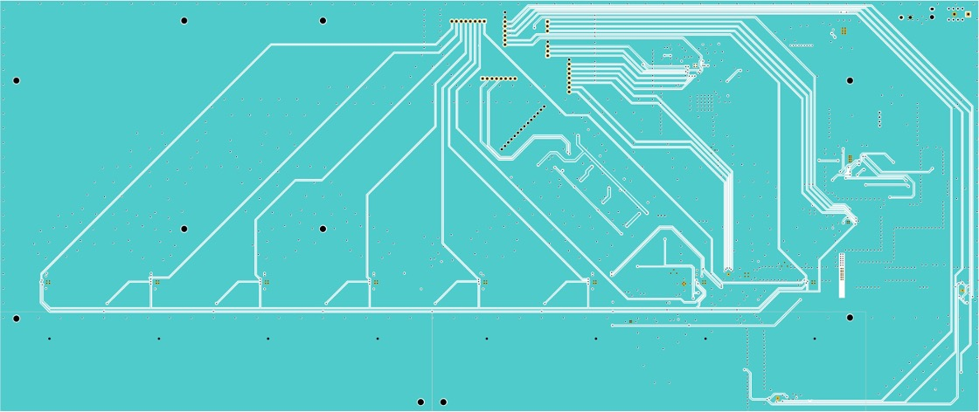
Layer 4 – Digital Signals

Slide 23
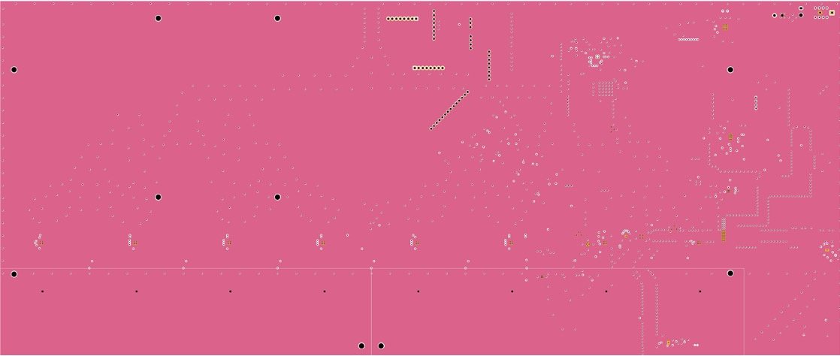
Layer 5 - Ground

Slide 24
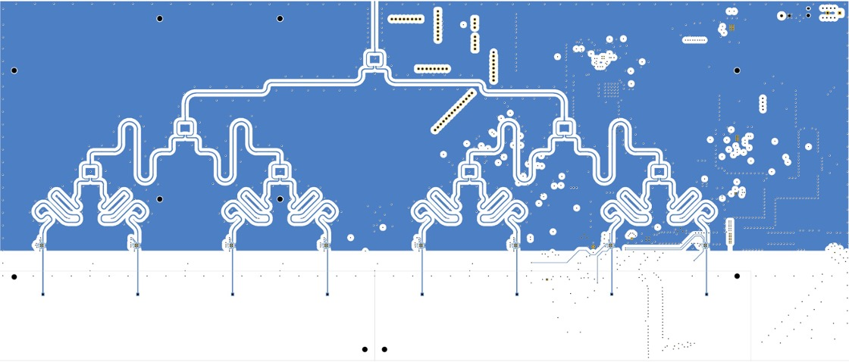
Bottom Layer – Antenna Feed

Slide 25
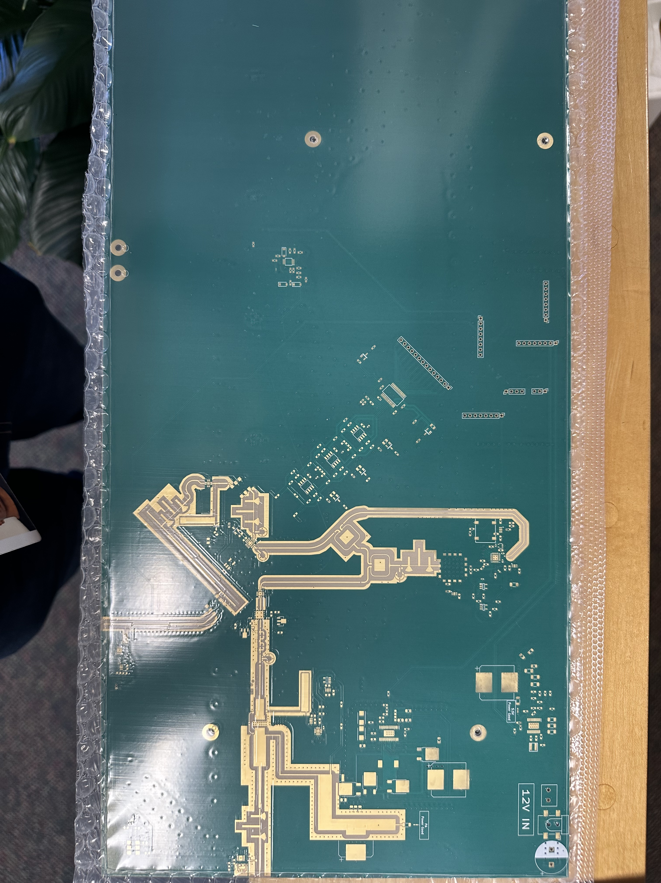
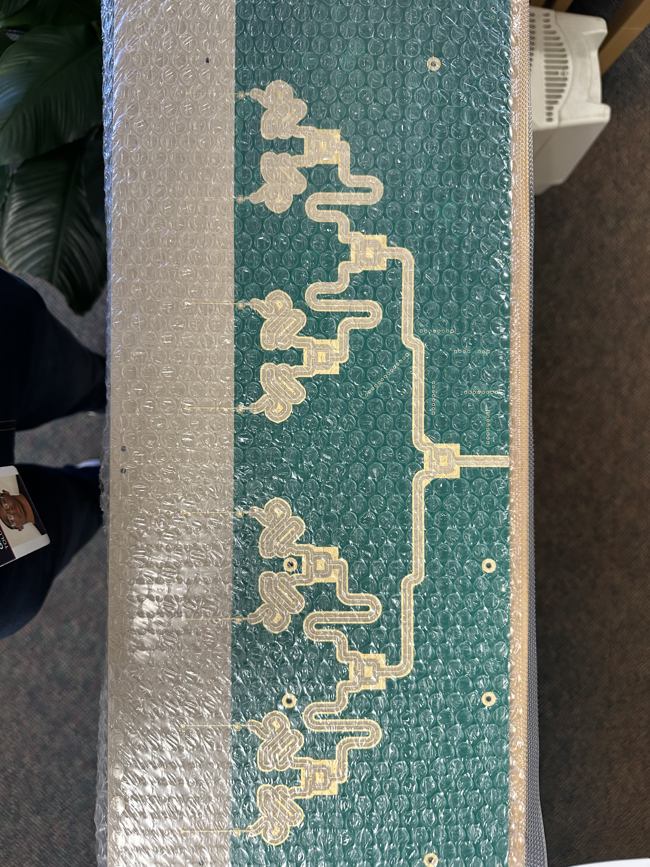
Fabricated Board

Slide 26
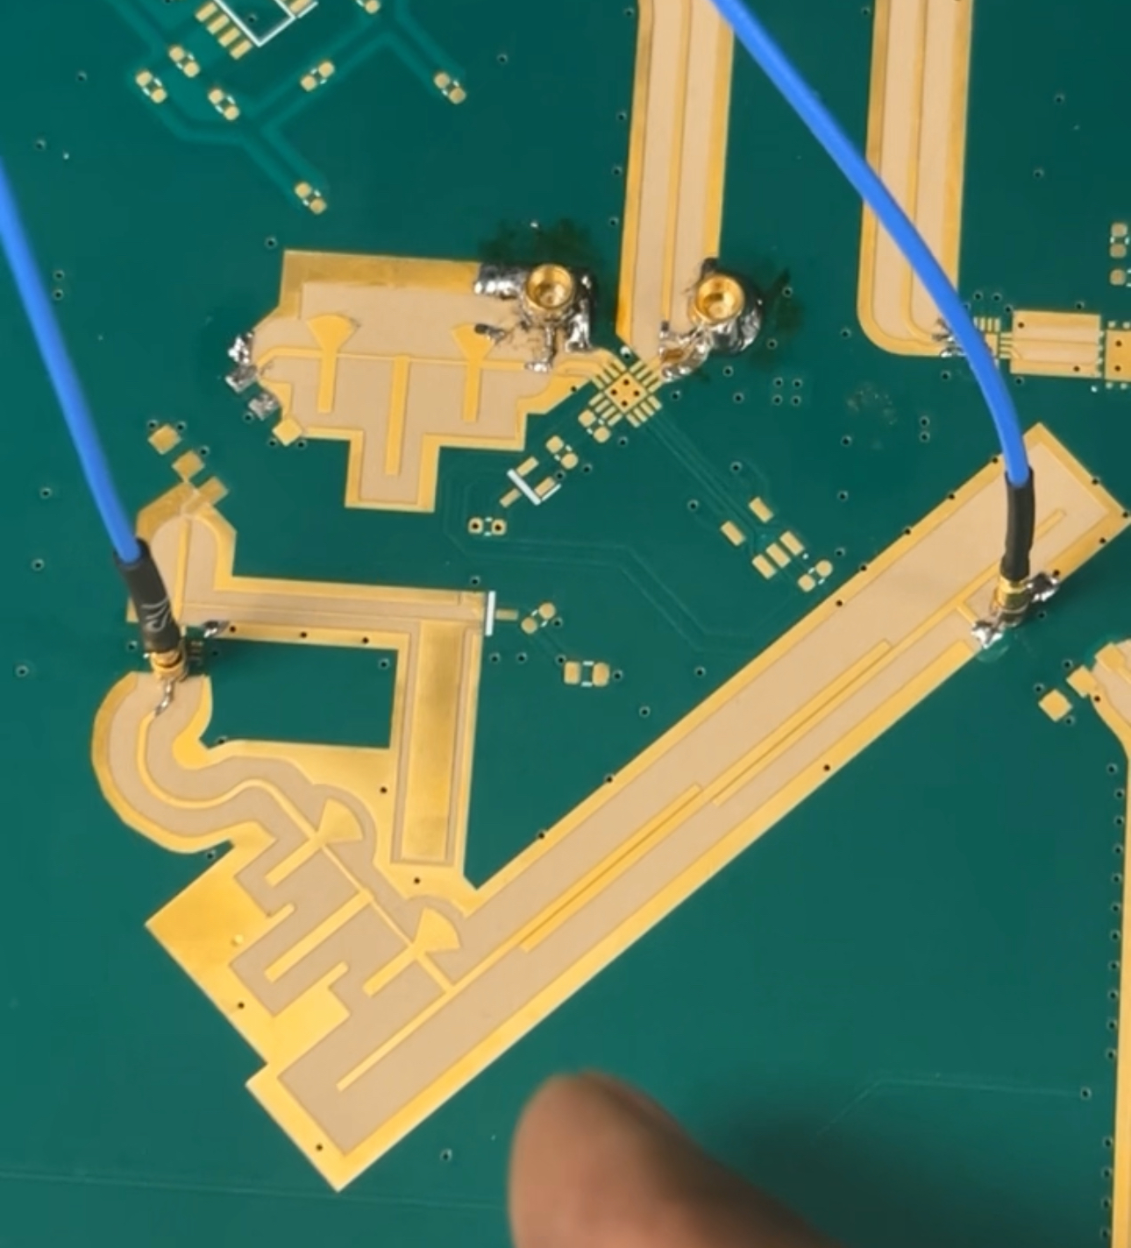
Measures vs Simulated Results
Red: Measured
Blue: Simulated
Sample S21 Measurement Taken of Bandpass & Lowpass Filter Using VNA
S21 is Power from port 1 to port 2 in Decibels (dB)
Port 2
Port 1

Slide 27
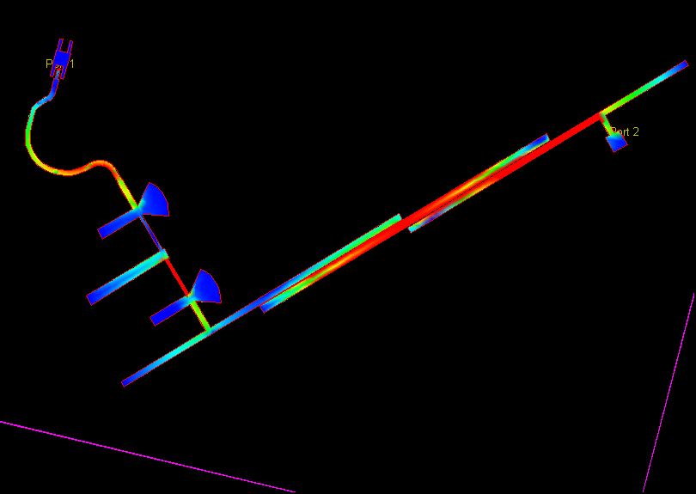
Snapshot Visualization Of Current Density at 3GHz
This structure is part of the receive chain and includes a coupled line bandpass and lowpass 2nd +3rd harmonic filters
Filtering is important to remove unwanted frequency/noise from polluting the desired object (return) signal

Slide 28
Work Left to Be done
Halfway done populating & soldering active components to the board
Etch & stack antenna structures
Measure transmit path and perform testing
Measure and perform testing on antenna array
Configure digital control & signal processing and

Slide 29
Work Citations
[1] Jubong Lee, Jinseo Hong And Kyihwan Park, " Frequency Modulation Control of an FMCW LiDAR Using a Frequency-to-Voltage Converter,” Sensors, vol. 23, no. 10, p. 4981, Month Year, doi: 10.3390/s23104981.
[2] Wikipedia contributors, "Phased array animation," Wikimedia Commons, Available: https://en.wikipedia.org/wiki/Phased_array#/media/File:Phased_array_animation_with_arrow_10frames_371x400px_100ms.gif. [Accessed: March 20, 2024].
[3] D. M. Pozar, Microwave Engineering, 4th ed. Hoboken, NJ, USA: Wiley, 2011.
[4] C. A. Balanis, Antenna Theory, Analysis and Design, 3rd ed. Hoboken, NJ, USA: Wiley, 2005.

